Slide 1
Aircraft Traffic Control with Reinforcement Learning
Abhinav Sethi: 19006
Hritik Bana: 19141

Slide 2
Motivation
ATC (Aircraft Traffic Control): Task to guide the planes and scheduling a conflict free route.
ATC essential for safety.
Increase in the demand for air-travel in recent years.
Leading to an increased number of flights.
Heavier load on the ATC.
Higher risk of mishappenings.
Therefore, need for a robust system capable of analyzing the complex data and suggesting solutions very rapidly.

Slide 3
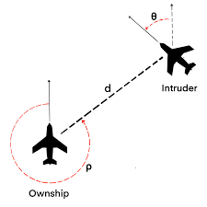
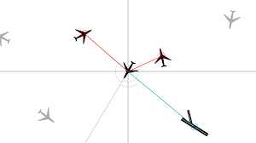
Problem Statement
Use the game python air traffic control built with pygame to simulate the 2D version of the task assigned to ATC.
Modify this game such that instead of guiding the aeroplanes manually, an agent does it in an intelligent way without any collisions.
Utilize reinforcement learning technique (SARSA) to train the agent.

Slide 4
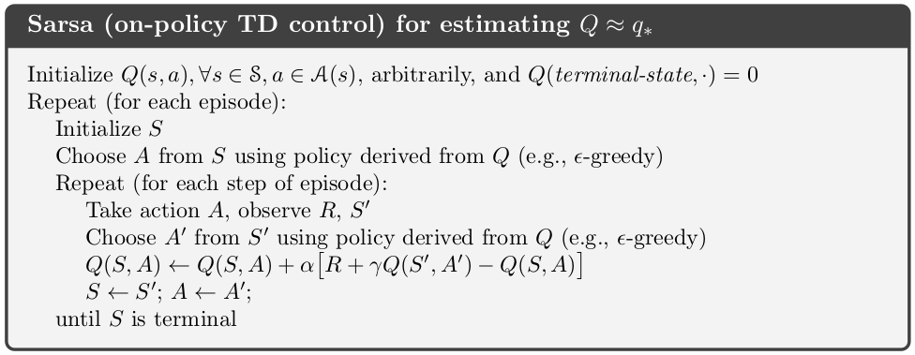
The SARSA Algorithm

Slide 5
Approach Taken
Removed the game menu and made the game continuous over episodes.
Made functions to get:
List of active aircrafts.
Potentially colliding aircrafts.
Reward for each aircraft at each timestep.
Trained the agent by:
Making a function to choose an action at each state following epsilon-greedy.
Using an update function to update the state-action value estimates according to SARSA.

Slide 6
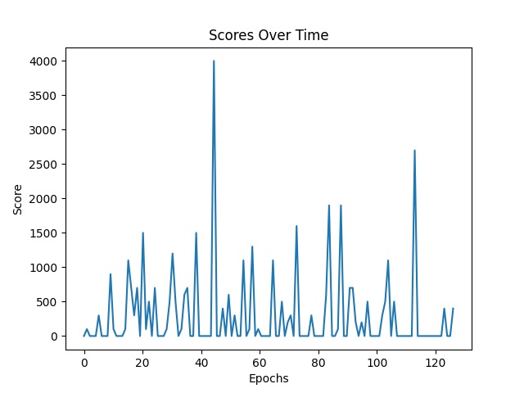
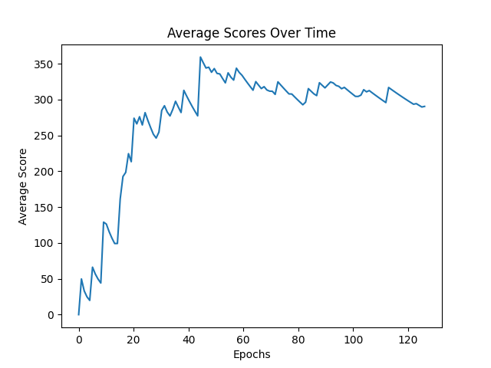
Results
Converted the game so that the agent can play it.
Agent was successfully rerouting the aeroplanes.
Similar plots for rewards were obtained as shown in the paper.

Slide 7
Results (Contd.)
A demo run of the SARSA-trained agent!
The gif on the left showcases the agent learning (Episode 0) to reroute the planes to avoid collisions, and ensure a safe arrival at the destination.
The agent is doing a pretty good job even though it has to manage 50 planes (specified by us for this simulation) in an episode.

Slide 8
THANK YOU!

